Slide 1
The Galactic Treasure Hunt Game

Slide 2
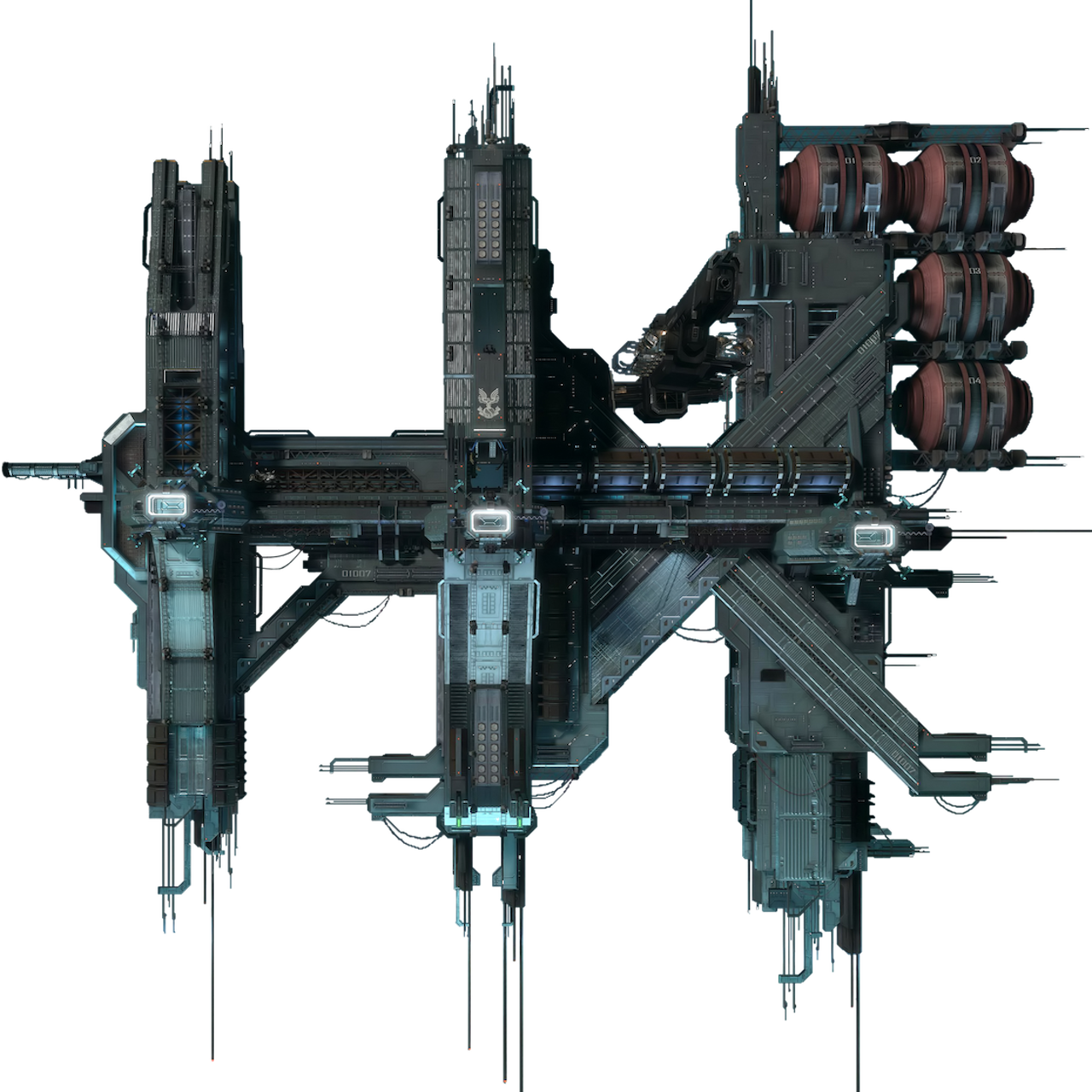







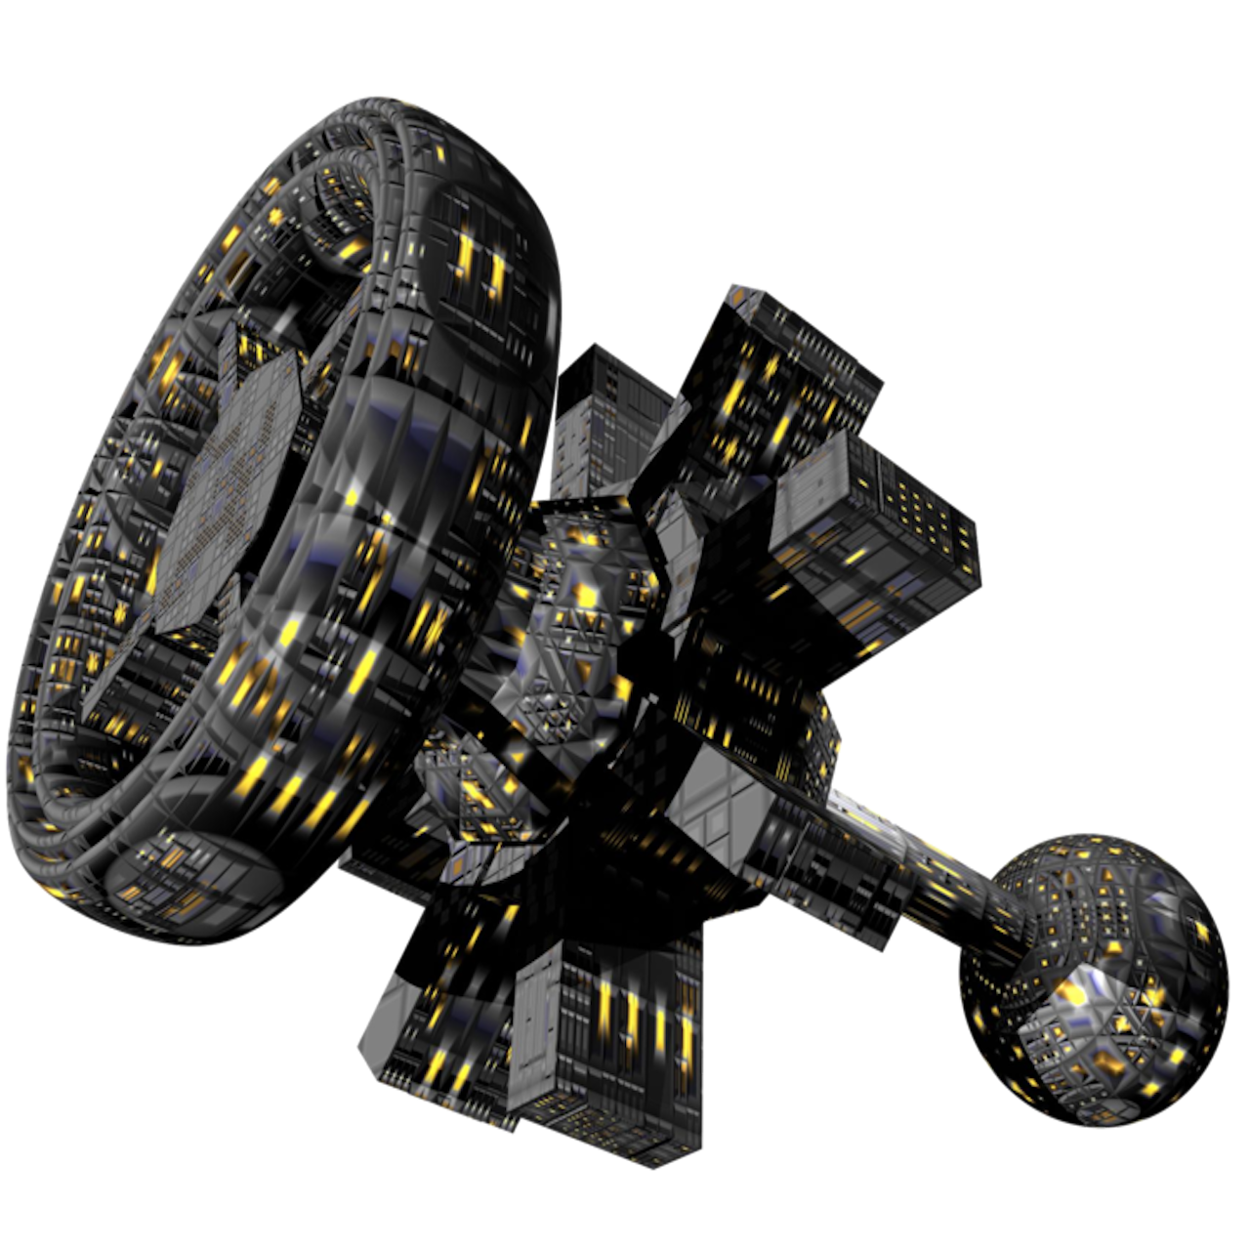
In this game, you travel from earth to some planets to collect points. Your payment will depend on how much you collected in your trips.
This is the map of the 365 journeys you will have:
Space station 1
Earth
Helium-Green
Helium-Blue
Space station 2

Slide 3
In this game, you travel from earth to some planets to collect points. Your payment will depend on how much you collected in your trips.
This is the map of the 365 journeys you will have:
Starting from earth, you choose either the black or red spaceship, and they take you to one of the two space stations.
From there, a portal takes you to one of the two Helium planets where the aliens put their money.
You will visit the Helium planets and collect the money there for 365 times (like a year composed of 365 days).
Space station 1
Earth
Helium-Green
Helium-Blue
Space station 2

Slide 4
Every day, depending on what space-station you arrive in from earth, the portal takes you to one of the two Helium planets.

Slide 5
Every day, depending on what space-station you arrive in from earth, the portal takes you to one of the two Helium planets.
However, once in a while, in an unpredictable way (usually every 4 to 9 days) a galactic storm happens and swaps the destination of the two portals.
galactic storm
galactic storm

Slide 6
Also, every day, depending on their mood, aliens put most of their money in one of the two Helium planets, and put less in the other one.
100
20

Slide 7
Also, every day, depending on their mood, aliens put most of their money in one of the two Helium planets, and put less in the other one.
However, once in a while (usually every 4 to 9 days), their mood changes and they shift their investment to the other planet.
To collect more money, you should try to figure out which helium planet is fashionable now.
mood change
100
20
mood change
20
100

Slide 8
Galactic storms (that change the destinations of the portals) and
the alien’s mood-swings (that change where they put their money)
happen totally independent from one another.

Slide 9
So here is how you play the game:
On most days, you start from the earth and you first choose your spaceships by pressing the “F” or “J” button on the keyboard.
But note that the location of the spaceships on the screen (but not their destination) might change everyday. So for choosing a specific spaceship, you should press the “F” on some days, but “J” on some other days.
You have less than one second to choose. If you don’t respond fast enough, you will miss the opportunity.
F
J
F
J

Slide 10
After you arrived in either of the spaceships, press the SPACEBAR quickly (in less than a second) and a galactic portal will open for you to go to the next planet.

Slide 11
Finally, when you arrive at either of the Helium planets, you should press the SPACEBAR quickly (in less than a second) to collect your money.
Once you see your reward, the next day automatically starts after one second.
or
or
100
20
100
20

Slide 12
On most of the days, your journey starts from earth.
Some days, however, you just wake up and find yourself in one of the two space stations. You should continue your journey from there.
In yet other days, you just wake up and find yourself in one of the two Helium planets. You should press the SPACEBAR to collect the reward there.

Slide 13
You must be ready to play the game now.
Good luck…

